Slide 1
INTELIGENT SYSTEMS
Neural networks– Denis, kacper and kirill.

Slide 2
Introduction
In this assignment we had two robots that were fighting, all of the battles were simulated, we had 1000 battles that took place. The expected result of this assignment is that we will obtain a prediction of behaviour of a robot based on these battles.
We will use the encog library and we use a main class of BattlefieldParameterEvaluator to get the results.
The matrix will be written as a grayscale png, allowing for the results of the estimation to be evaluated visably.

Slide 3
Explaining Battlefield parameter evaluator
There is three classes in this class:
Environment
BattlefieldParameterEvaluator
BattleObserver
The class Environment is responsible for running the Evaluater with the amount of Samples we preditermine.
The Battlefield Parameter Evaluator creates a dataset for the network by running sample battles, then a network is created and trained using the dataset. Then samples are created and evaluated by the neural network. The outputs given by the network are used for plotting the graph i.e. The image at the end we obtain. In this class the image is created also.
Battle observer is the battle listener for handing the battle events we are interested in. Whenever a battle has finished, the class provides an output of the scores of the robots in the console.

Slide 4
Encog library
The Encog Library is a Java library responsible for machine learning in Java.
Encog’s main strenght is that it supports neural network algorithms.
Encog allows us to use classes to normalize and process data for these neural networks.
Nearly all neural networks contain layers. A layer is a group of neurons that behave similarly. There are many different layer types used by the different types of neural networks that are supported by Encog.

Slide 5
Training explanation
We create a dataset and we normalize the inputs of the dataset to have an interval of the form [0,1].
We use an Activation Sigmoid function to predict our outcomes, and we use it to create the training network. The Sigmoid function is part of the Encog library. The range for sigmoid is set from 0 to 1.
Our network has one hidden layer consisting of 50 hidden units with no bias, output is a single value - normalized score of a robot.
The Propagation technique is then used to train the network that we have created and also the dataset.
The synapses and weights are adjusted in this project to find the robot’s strenght and weaknesses.

Slide 6
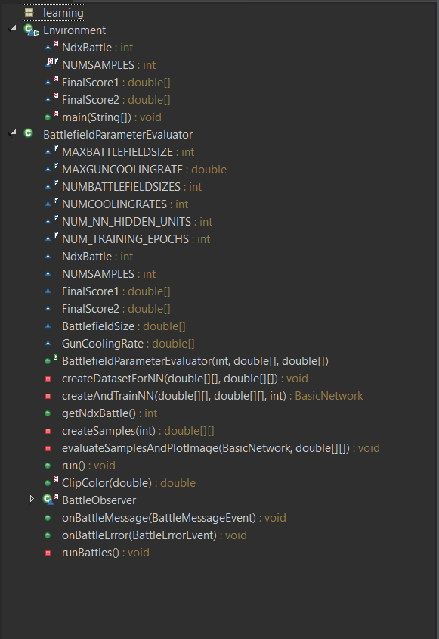
Class diagram

Slide 7
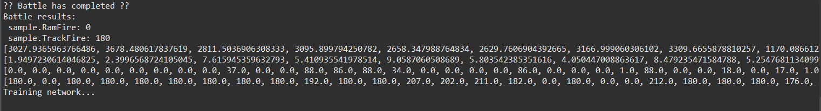
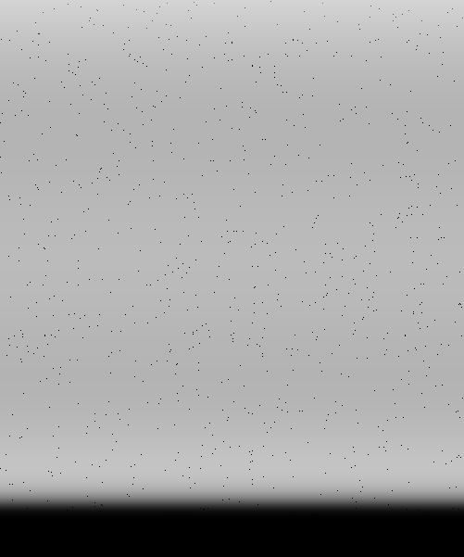

Results
The brighter the pixel is, the better score should the second robot(The second robot - on the left image, the first robot - on the right one respectively)achieve in a battle with corresponding configuration of battlefield size and gun cooling rate.
We can see that based on the training data the neural network expects the second robot to achieve much better results than the first one.
On console we can see the set ups for who the network has been trained and also the scores of the robots in the battles with those set ups
Solution after observing first robot scores
Solution with current config

Slide 8
Conclusion
One of the most striking facts about neural networks is that they can simulate any function.
In our case we run 1000 tests on two robots, we changed the observed robot to see the output for two each of the battling sides. So we had obtained two images to show the result of the evaluation.
As expected the more trainings we had specified the more precise the evaluation gets, as overtime the proporties are altered and outliers are eliminated to get the best results.

